Slide 1
Operational Investigation of Customer Differential Pressure (DP) Performance
Question Investigated
Under what operating conditions does customer DP fall below the 12 psi upset threshold?
Key Findings
Customer DP fell below the 12 psi upset threshold in 21% of observations.
Peak operating conditions increased threshold breaches by approximately 75% compared with non-peak operation.
Weather and system demand consistently showed the strongest association with reduced customer DP.
System output pressure was the strongest controllable operational variable associated with improved DP.
Business Objective
Identify the operational conditions associated with customer DP falling below the 12 psi upset threshold and recommend practical operational actions to reduce customer risk.
This investigation identifies the operational conditions associated with customer DP deterioration and recommends actions to reduce customer upset events.

Slide 2
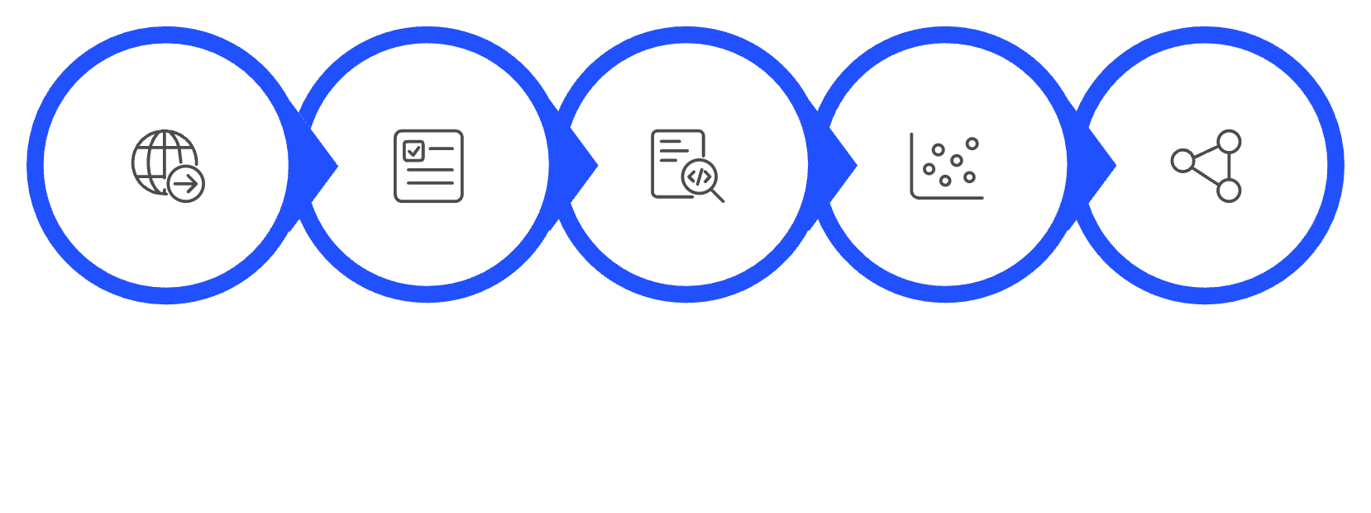



CONTEXT & FRAMING
Business Problem, Objective & Business Value
Why 12 PSI Matters ?
Objective & Methodology
12 psi is the upset threshold — not a target. Readings below this level indicate a service delivery failure, not a performance gap.
Understanding when and why DP falls below threshold is the first step toward proactive operations rather than reactive response.
Identify the operational conditions statistically associated with customer DP falling below the 12 psi upset threshold.
Data Extraction
Quality Assurance
Exploratory Analysis
Regression Modelling
Interaction Analysis
Customer Reliability
Operational Decision-Making
Proactive Operations
Quantify how often and under what conditions customers are at risk of receiving below-threshold pressure
Identify controllable levers — output pressure, plant dispatch — that can reduce upset frequency
Enable weather-informed, demand-aware risk monitoring before upsets occur — not after

Slide 3
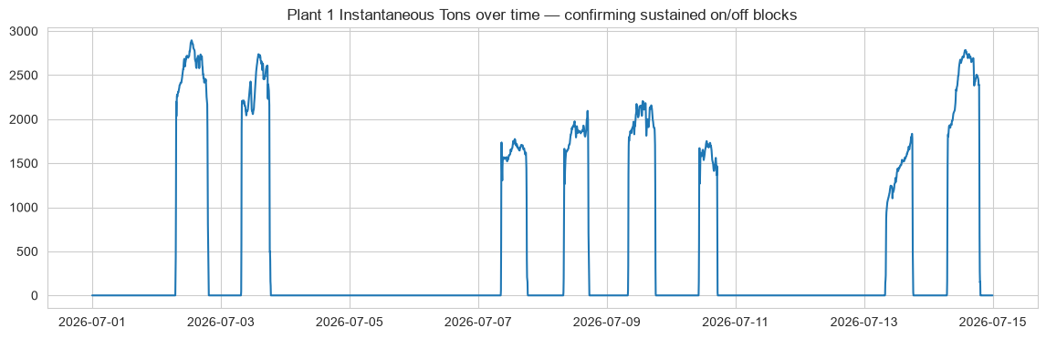

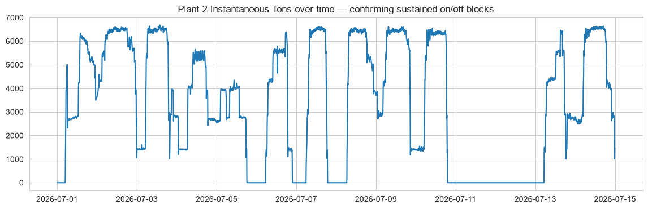



DATA FOUNDATION
Building Confidence in the Analysis
Dataset Summary
4,032 operational observations at five-minute interval resolution over the two-week operating period (July 1–15, 2026). 336 Hourly weather data — Humidex — was aligned to operational timestamps. Nine predictor variables including plant output, system flow, temperatures, and time-of-day features were prepared for modelling.
Data Quality Checks
✓ No duplicate timestamps identified
✓ No duplicate observations confirmed
✓ Weather data successfully aligned to operational records
✓ Feature engineering completed —like hourly timestamp, temperature_delta_f
✓ Negative Plant 2 readings represented periods when the plant was offline and were standardized to zero before modelling.
Data quality checks confirmed the dataset was analytically ready. No material issues were identified that would compromise the reliability of modelling results.

Slide 4
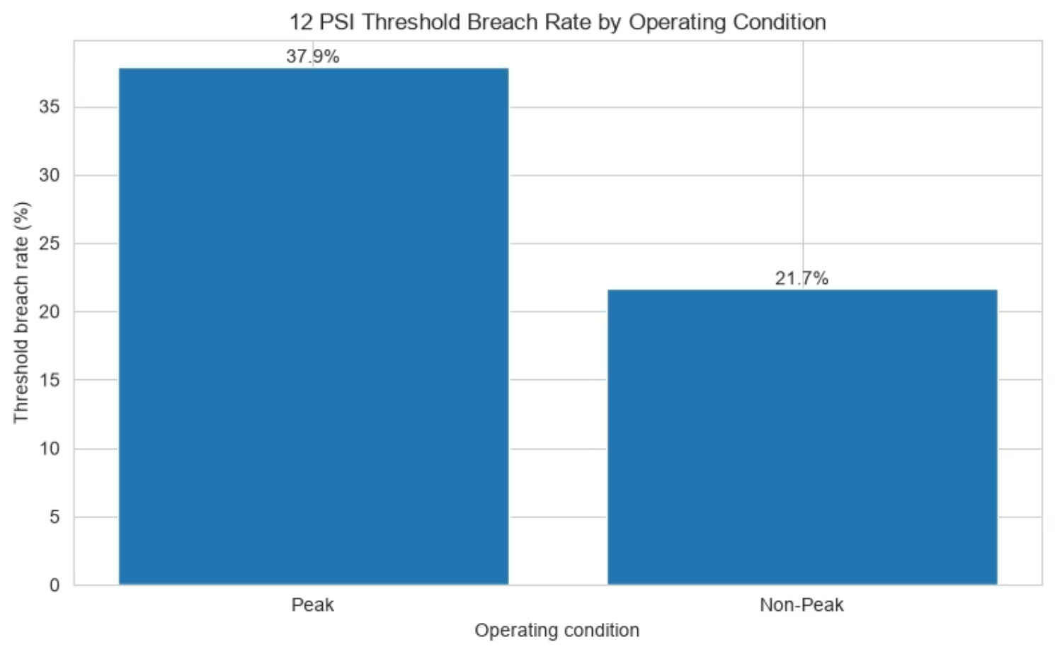

RISK QUANTIFICATION
DP Risk Increases Materially During Peak Conditions
21%
37.9%
Overall Breach Rate
Peak Breach Rate
Across all 4,032 observations in the two-week period
1,008 five-minute observations · avg DP 13.57 psi · min 5.68 psi
21.7%
13.57
Non-Peak Breach Rate
Avg Peak DP (psi)
263 hours assessed · avg DP 18.66 psi · min 5.93 psi
Only 1.57 psi above the 12 psi upset threshold — a thin margin
Peak vs. Non-Peak Breach Rate Comparison
Operational Significance
The peak breach rate of 37.9% is 75% higher than the non-peak rate of 21.7% — a material operational difference that represents a meaningful operational increase in customer service risk..
During peak cooling periods, customer DP is approaching the upset threshold on average, meaning that any incremental increase in demand or reduction in output pressure is sufficient to trigger a service delivery failure.
Peak conditions were analytically defined as the highest quartile of total cooling production. A formal operational definition was unavailable. Note: Peak data assessed at 5-minute resolution; non-peak at hourly resolution — direct rate comparison should account for this difference in granularity.
So What?
Peak operating periods represent the highest customer service risk and should receive the highest level of operational monitoring

Slide 5
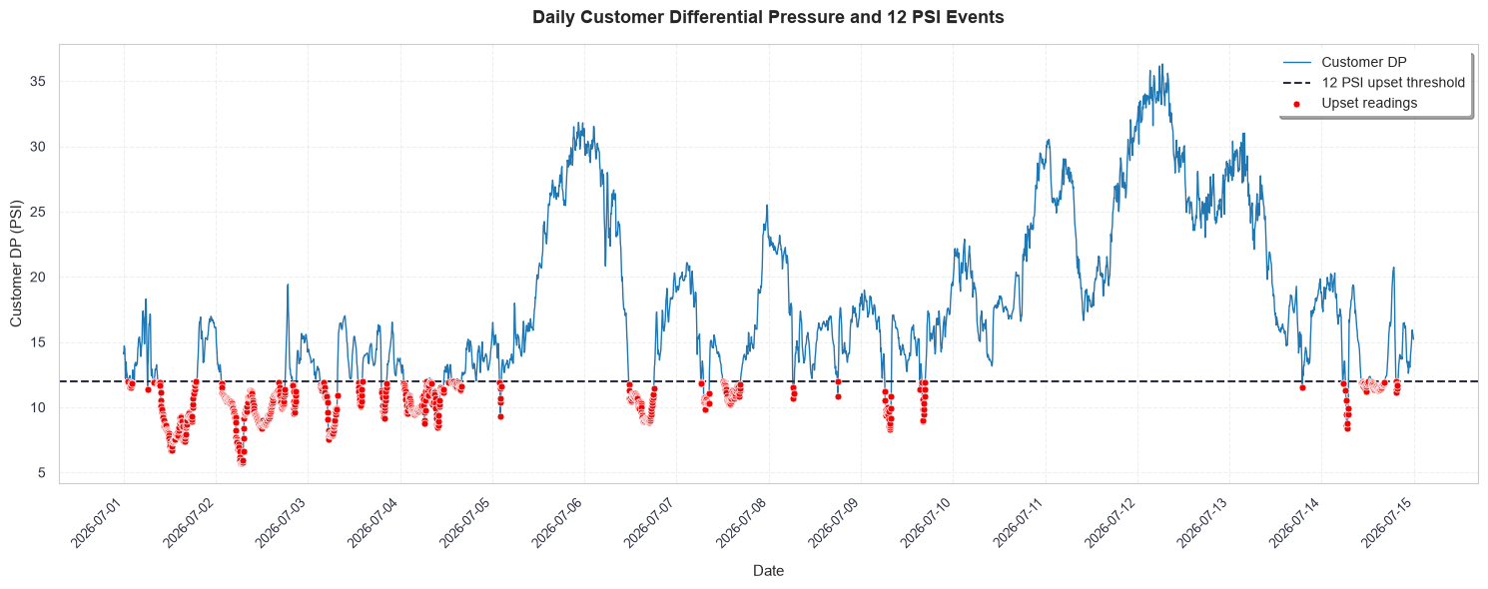

TEMPORAL PATTERN ANALYSIS
Customer DP Does not Deteriorate Randomly
Do Threshold breaches occur Randomly?
Operational Implication: Customer DP deterioration follows identifiable operational patterns rather than random events. From an Operational Perspective, because predictable problems can be proactively managed.

Slide 6
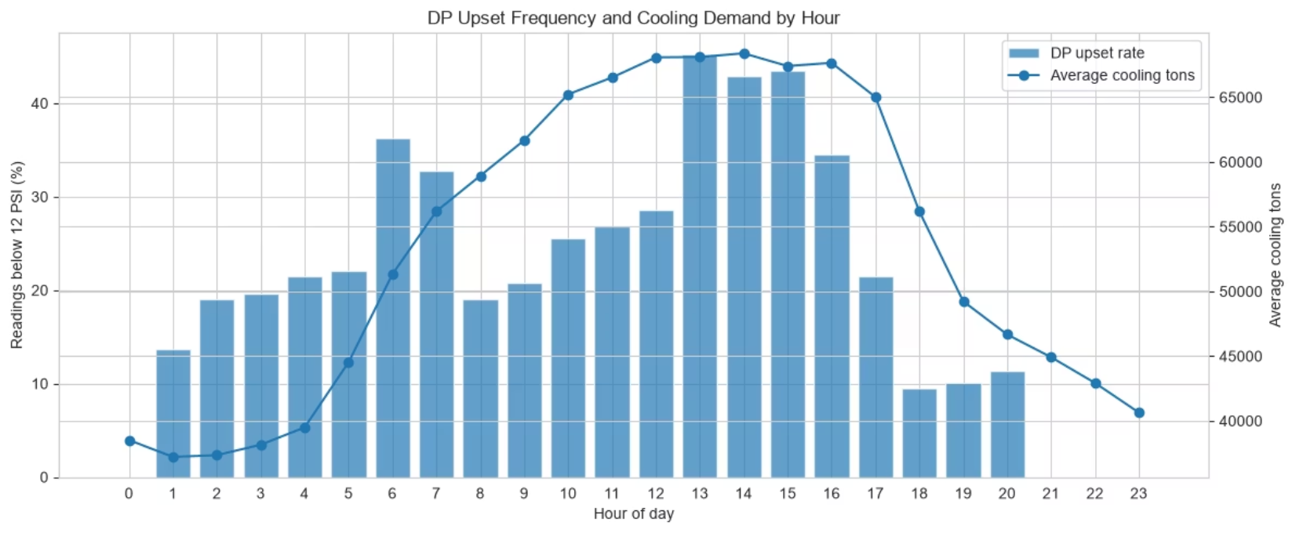
TEMPORAL PATTERN ANALYSIS
Customer DP Risk Follows the Daily Demand Cycle
When Does Customer Risk Increase?
Customer DP risk peaks during the early-to-mid afternoon, aligning closely with the system's highest cooling demand.
Operational Implication: Since DP problems cluster predictably in the 1pm–4pm window (and to a lesser extent around 6-7am), operations doesn't need to monitor DP equally hard all day — it can shift to active, closer monitoring specifically during those peak hours (real-time 5-minute checks, staff attention, maybe pre-emptive adjustments before 1pm), while relying on lighter, hourly-level monitoring the rest of the day. This enables more efficient use of operator attention than treating every hour as equal risk, and it gives the team a specific, actionable window to focus corrective action or staffing on

Slide 7
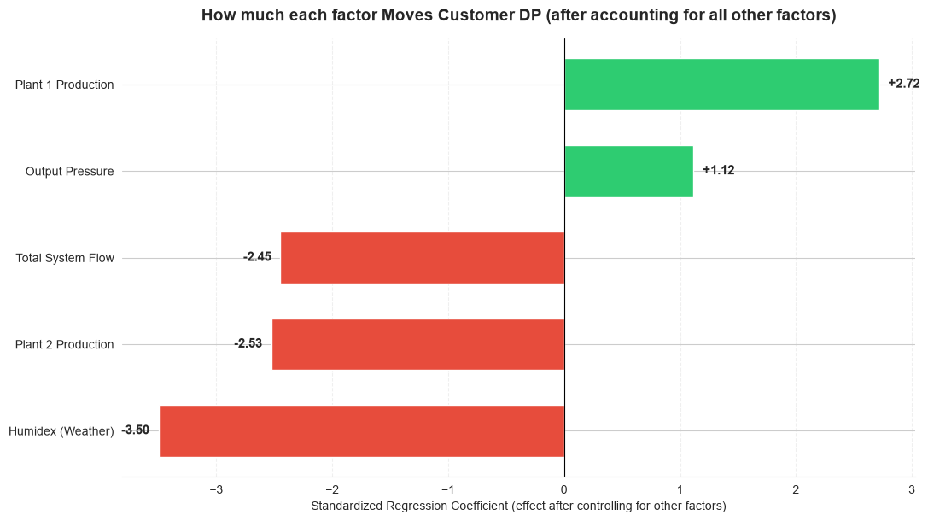

DRIVER ANALYSIS
What Are the Main DP Drivers ?
SHAP analysis independently confirmed Humidex and system flow as the two most influential variables overall
Operational takeaway: Model explains 78.6% of the variation in customer differential pressure. The remaining 21% is likely due to factors not included in the model. Customer DP is most vulnerable when high Humidex and high system flow occur together. Output pressure and plant dispatch are the main controllable areas for operational review.
Humidex (−3.5) — Strongest Negative Driver
System Flow (−2.45) — Hydraulic Loss Driver
After accounting for flow, plant production, output pressure, and time effects, higher Humidex is associated with lower customer DP. This indicates that hot and humid conditions place the greatest overall pressure on DP performance.
Higher system flow is associated with lower customer DP after controlling for the other operating conditions. This is consistent with greater hydraulic losses when the network is under heavier demand.
Plant 1 Tons (+2.72) — Positive Conditional Effect
Higher Plant 1 production is associated with improved customer DP when the other operating conditions are held constant. This suggests that Plant 1 dispatch may support DP stability under certain system conditions, but the relationship should be validated operationally before changing plant loading strategy.
Plant 2 Tons (−2.53) — Strong negative Association
Output Pressure (+1.12) — Controllable Lever
Higher Plant 2 production tends to occur when customer DP is lower. Because this is an observational relationship, it should be investigated alongside plant dispatch strategy before drawing operational conclusions.
Higher system output pressure is associated with improved customer DP after accounting for the other factors. This makes output pressure an important operational lever to review during high-risk demand periods, subject to pump and network limits.

Slide 8
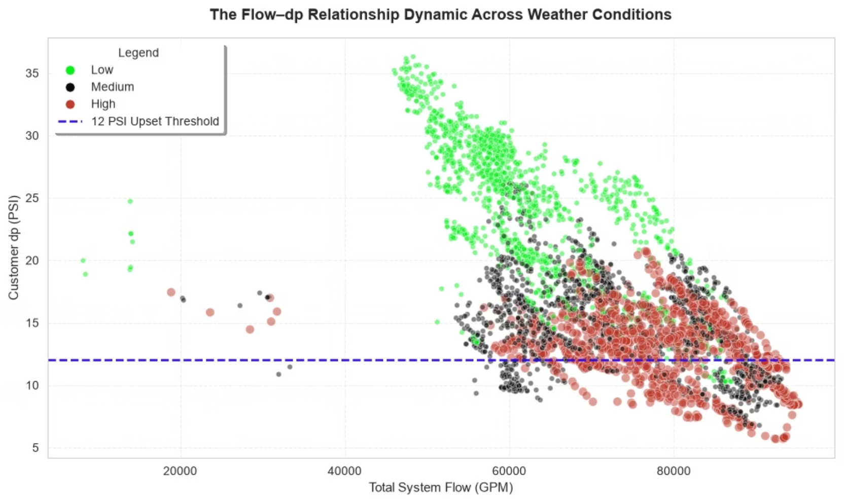
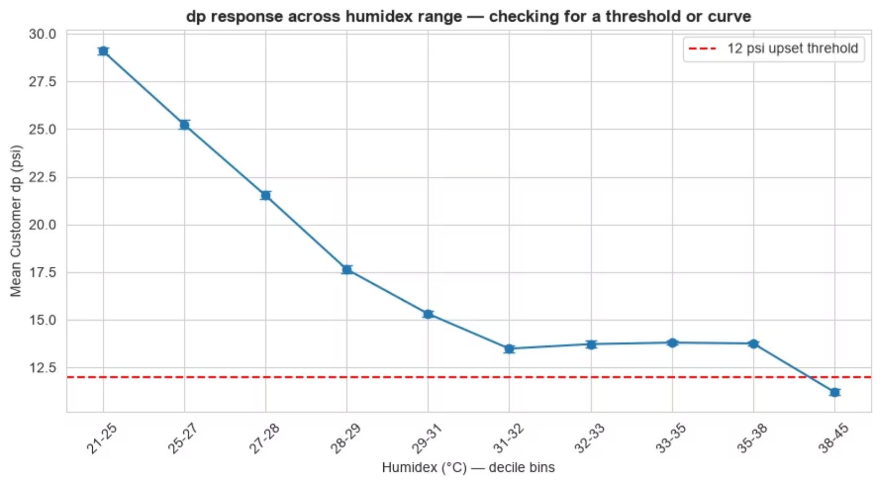
INTERACTION EFFECTS
Weather Changes How System Flow Affects Customer DP
Flow–Humidex Interaction: DP Response by Weather Regime
Nonlinear Humidex Effect on Mean Customer DP
Under low Humidex (The bottom 33%): high flow still delivers DP well above 12 psi — system performs reliably. Under medium Humidex (middle 33%): DP begins compressing toward threshold at high flow volumes. Under high Humidex (top 33%): even moderate flow levels push DP below 12 psi — the system is in a fundamentally different operating regime.
Mean customer DP drops sharply as Humidex rises from 21°C to ~32°C, then flattens near the 12 psi threshold. The relationship is nonlinear — a single Humidex coefficient understates risk at the high end of the weather range.
Interaction Model R²
Heteroskedasticity Autocorrelation Consistent
Operational Takeaway
0.786 — explains 78.6% of DP variance using individual predictors. Adding interaction and nonlinear terms improved model’s explanatory power to 0.865
Used HAC – to improve statistical confidence in factors affecting DP by correcting the standard errors
Monitor DP using combined weather and other operating variables — not individual variables in isolation

Slide 9
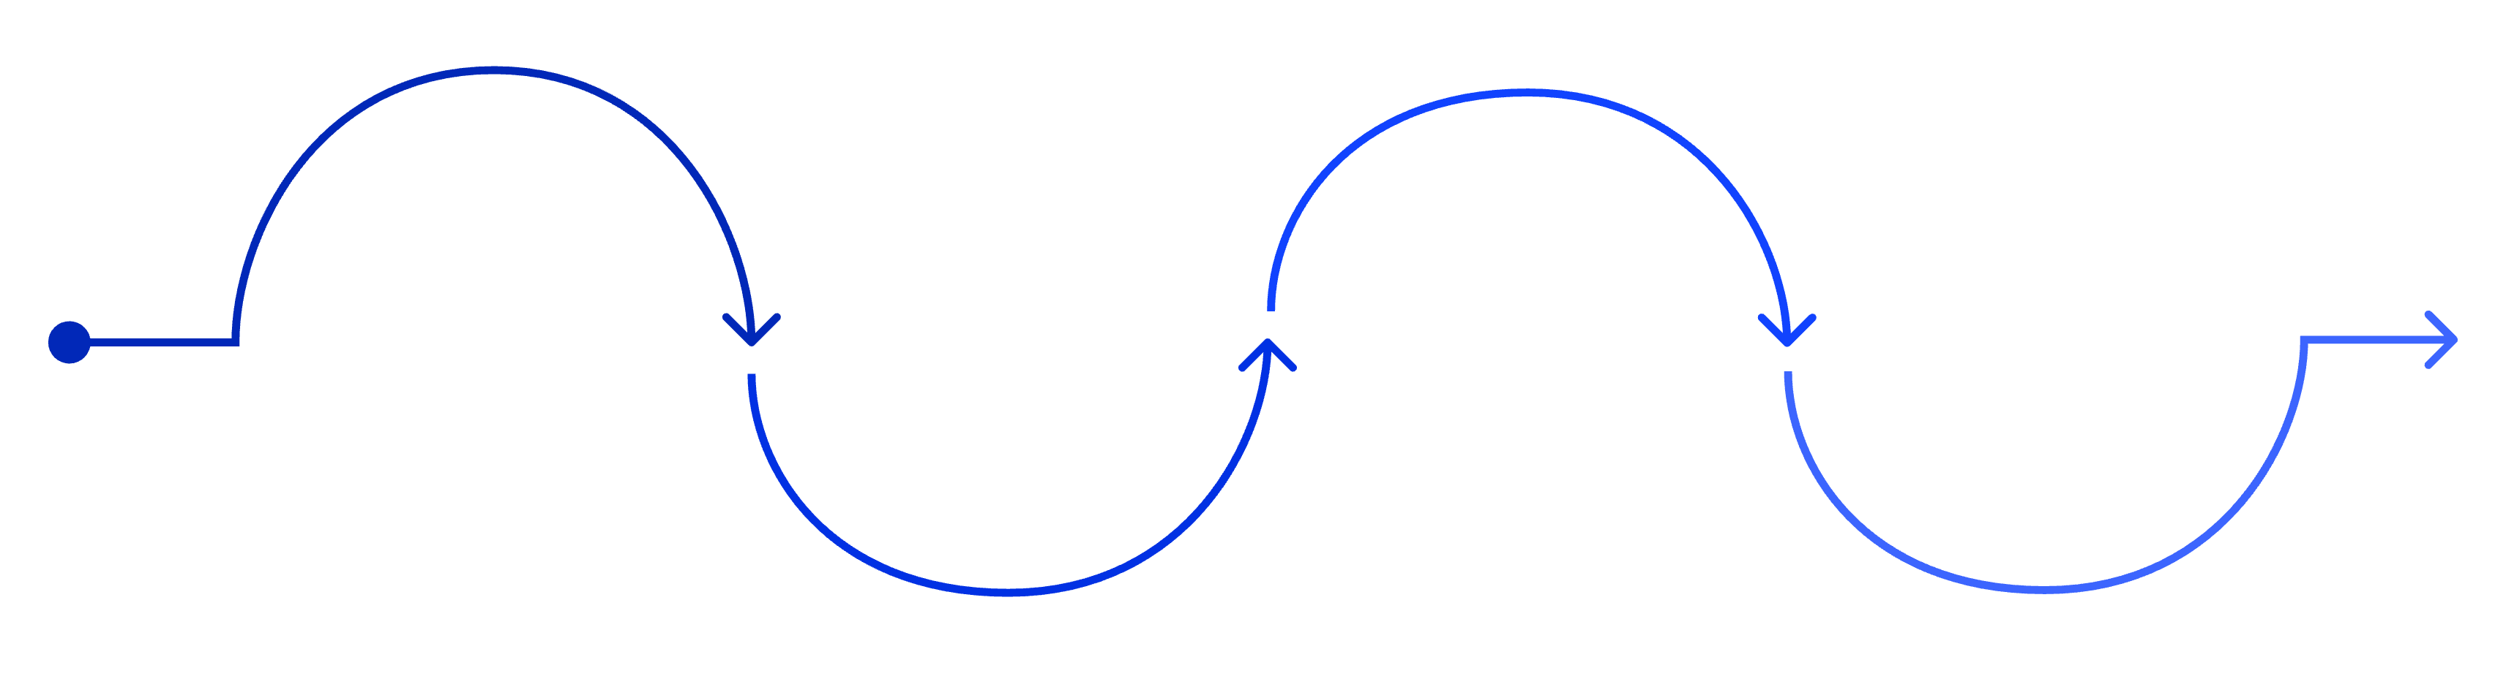
RECOMMENDATIONS
Move From Reactive to Proactive Risk Management
Short Term Actions
Medium Term Improvements
Introduce a warning band above 12 psi (e.g., 13–14 psi) to provide early alert before threshold breach — not after
Continue five-minute monitoring during peak conditions; hourly resolution is insufficient to capture the speed of DP deterioration during high-demand periods
Develop combined DP risk alerts that trigger on Humidex + flow combinations, not single-variable thresholds
Review output pressure strategy during forecast high-demand periods — it is the strongest controllable positive lever identified in the analysis
Review plant dispatch strategy — Plant 2's negative association with customer DP warrants investigation with Operations; Plant 1 and Plant 2 behave differently under load
Monitor upset event duration, not just frequency — a 20-minute breach has materially different customer impact than a 2-minute spike
Add predictive weather monitoring to operational planning; Humidex forecasts can provide 12–24 hour advance warning of elevated DP risk windows
Warning Band
Weather Dispatch
Predictive DP
Combined Alerts
Early alert above 12 psi
Forecast depressurization events
Merge sensor and operational signals
Adjust crew based on forecasts
Recommendations are prioritized based on operational feasibility, potential customer impact, and the statistical evidence observed during the analysis period. Validate recommendations jointly with Operations, Plant Chiefs, and Engineering before modifying dispatch or pressure strategies.

Slide 10
GOVERNANCE & NEXT STEPS
Operational Considerations & Next Steps
Analytical Assumptions Used
Operational Validation
Future Operational Opportunities
Peak conditions were analytically defined using the highest quartile of total cooling production — a formal operational peak definition was not available for this analysis.
Non-peak monitoring used hourly assessment in accordance with the case clarification provided
Results represent the observed two-week operating period (July 1–15, 2026) and should be interpreted within that context
Validate findings over additional operating seasons — a two-week summer window may not represent full annual system behaviour
Confirm plant dispatch behaviour with Operations — the Plant 2 negative association requires engineering and operational review before any dispatch changes are made
Compare findings with engineering operating limits and existing control setpoints to ensure recommendations are within safe operating bounds
Incorporate other system features gotten from telemetry data to improve model specificity
Develop predictive DP risk forecasting using weather forecast inputs (24–48 hour Humidex outlook)
Integrate findings into a Power BI operational dashboard for daily monitoring by plant operations team.
What would Success Look Like?
Fewer DP upset events, Improved Service Reliability, Stable building Temperatures.
Early DP warning, Better operation attention, Improved decisions during high demand
Reduced complaint, Better System Reliability, Data driven operational decision making

Slide 11
Thank you !
Questions & Discussion
by Nd Fyneface

